Slide 1



ML/DL for Everyone with
Lecture 2: Linear Model
Sung Kim <hunkim+ml@gmail.com> HKUST
Code: https://github.com/hunkim/PyTorchZeroToAll
Slides: http://bit.ly/PyTorchZeroAll

Slide 2

Call for Comments
Please feel free to add comments directly on these slides.
Other slides: http://bit.ly/PyTorchZeroAll
Picture from http://www.tssablog.org/archives/3280

Slide 3
ML/DL for Everyone with
Lecture 2: Linear Model
Sung Kim <hunkim+ml@gmail.com> HKUST
Code: https://github.com/hunkim/PyTorchZeroToAll
Slides: http://bit.ly/PyTorchZeroAll

Slide 4

Machine Learning
What would be the grade if I study 4 hours?
4 hours
? points
Prediction
Hours (x) | Points (y)
1 | 2
2 | 4
3 | 6
4 | ?
Training dataset
Test dataset

Slide 5

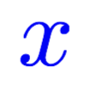
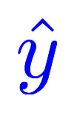
Model design
What would be the best model for the data? Linear?
Hours (x) | Points (y)
1 | 2
2 | 4
3 | 6
4 | ?
Linear
Notes:
\hat{y}=x*w+b

Slide 6

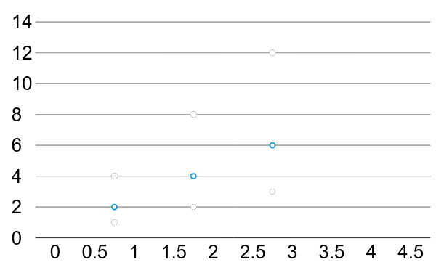
Linear Regression
Hours (x) | Points (y)
1 | 2
2 | 4
3 | 6

Slide 7
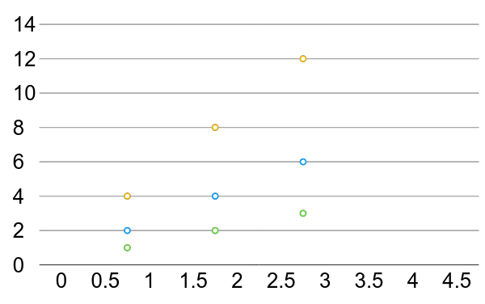
Linear Regression error?
Hours (x) | Points (y)
1 | 2
2 | 4
3 | 6

Slide 8
Training Loss (error)
Hours, x | Points, y | Prediction, y^(w=3) | Loss (w=3)
1 | 2 | 3 | 1
2 | 4 | 6 | 4
3 | 6 | 9 | 9
 |  |  | mean=14/3
Notes:
loss = (\hat{y}-y)^2 = (x*w-y)^2

Slide 9
Training Loss (error)
Hours, x | Points, y | Prediction, y^(w=4) | Loss (w=4)
1 | 2 | 4 | 4
2 | 4 | 8 | 16
3 | 6 | 12 | 36
 |  |  | mean=56/3
Notes:
loss = (\hat{y}-y)^2 = (x*w-y)^2

Slide 10
Training Loss (error)
Hours, x | Points, y | Prediction, y^(w=0) | Loss (w=0)
1 | 2 | 0 | 4
2 | 4 | 0 | 16
3 | 6 | 0 | 36
 |  |  | mean=56/3
Notes:
loss = (\hat{y}-y)^2 = (x*w-y)^2

Slide 11
Training Loss (error)
Hours, x | Points, y | Prediction, y^(w=1) | Loss (w=1)
1 | 2 | 1 | 1
2 | 4 | 2 | 4
3 | 6 | 3 | 9
 |  |  | mean=14/3
Notes:
loss = (\hat{y}-y)^2 = (x*w-y)^2

Slide 12
Training Loss (error)
Hours, x | Points, y | Prediction, y^(w=2) | Loss (w=2)
1 | 2 | 0 | 0
2 | 4 | 0 | 0
3 | 6 | 0 | 0
 |  |  | mean=0
Notes:
loss = (\hat{y}-y)^2 = (x*w-y)^2

Slide 13
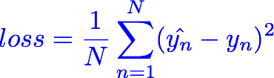
Training Loss (error)
MSE, mean square error
Hours, x | Loss (w=0) | Loss (w=1) | Loss (w=2) | Loss (w=3) | Loss (w=4)
1 | 4 | 1 | 0 | 1 | 4
2 | 16 | 4 | 0 | 4 | 16
3 | 36 | 9 | 0 | 9 | 36
 | MSE=56/3=18.7 | MSE=14/3=4.7 | MSE=0 | MSE=14/3=4.7 | MSE=56/3=18.7
Notes:
loss = (\hat{y}-y)^2 = (x*w-y)^2

Slide 14
Loss graph
Loss (w=0) | Loss (w=1) | Loss (w=2) | Loss (w=3) | Loss (w=4)
mean=56/3=18.7 | mean=14/3=4.7 | mean=0 | mean=14/3=4.7 | mean=56/3=18.7
Loss
w
Notes:
loss = (\hat{y}-y)^2 = (x*w-y)^2

Slide 15
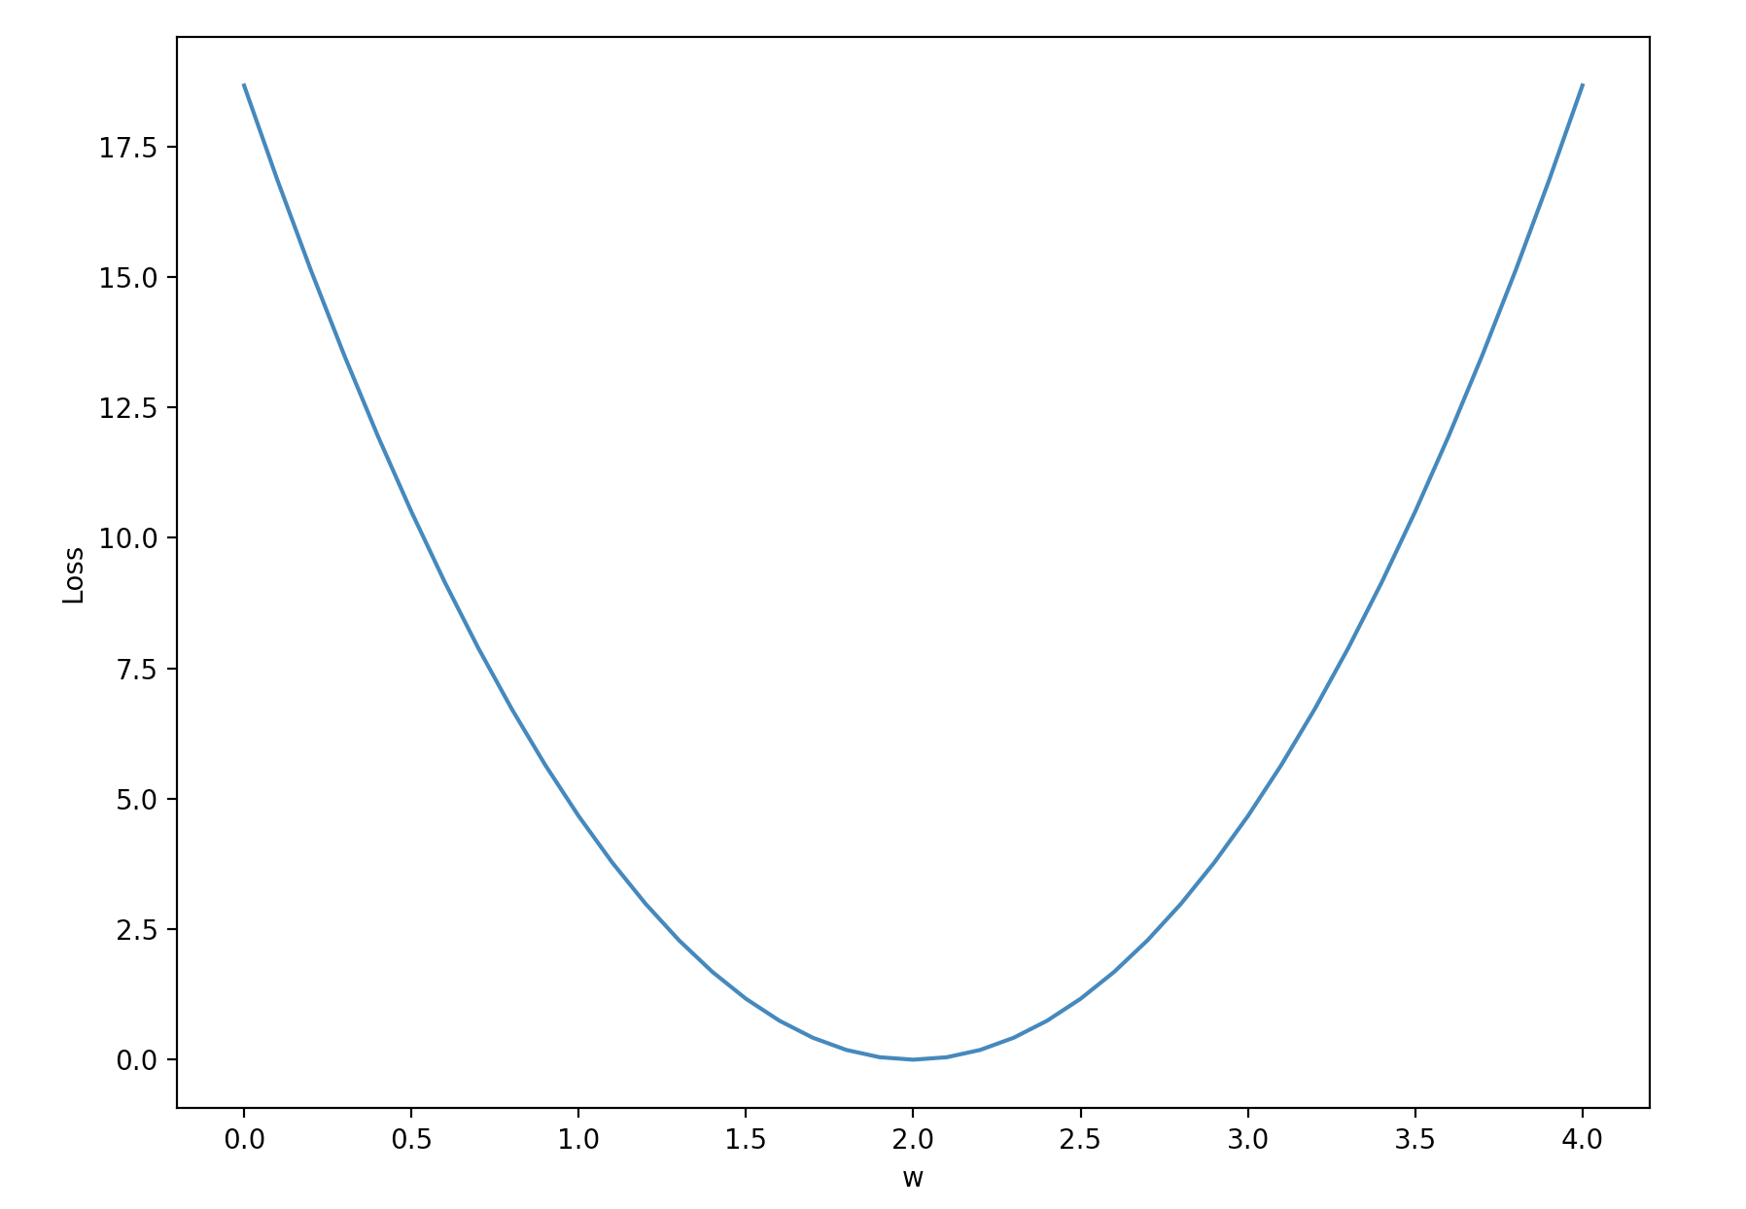
Loss graph
Loss (w=0) | Loss (w=1) | Loss (w=2) | Loss (w=3) | Loss (w=4)
mean=56/3=18.7 | mean=14/3=4.7 | mean=0 | mean=14/3=4.7 | mean=56/3=18.7
Notes:
loss = (\hat{y}-y)^2 = (x*w-y)^2

Slide 16

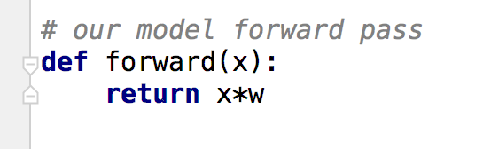
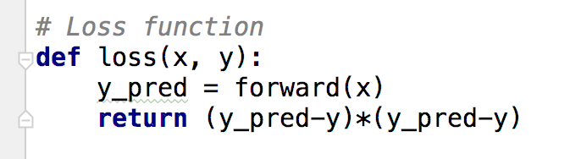

Model & Loss

Slide 17

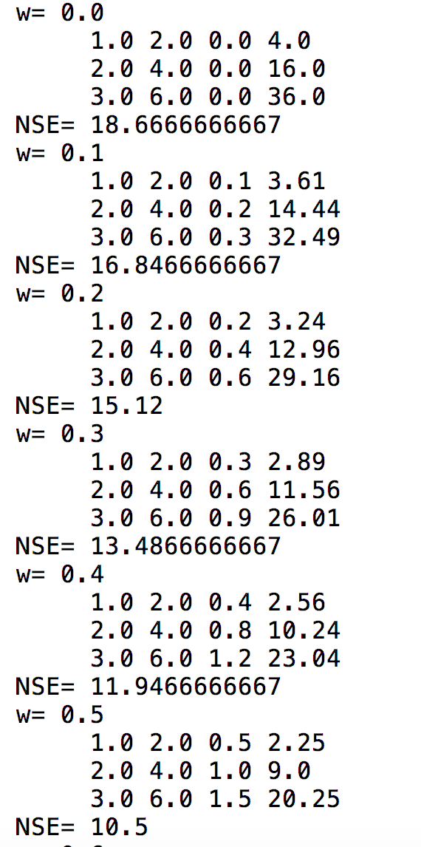
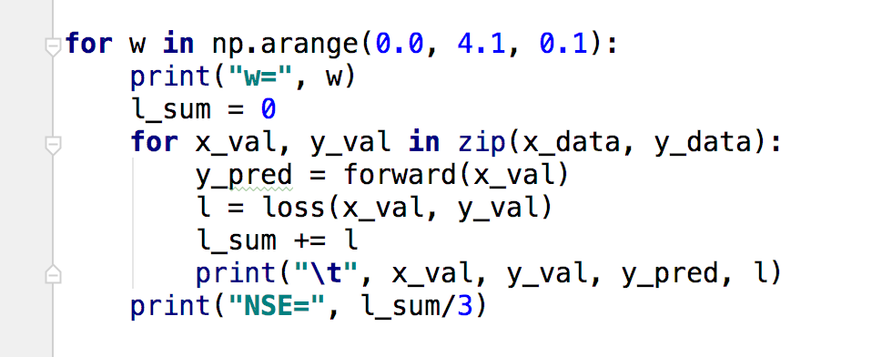
Compute loss for w

Slide 18
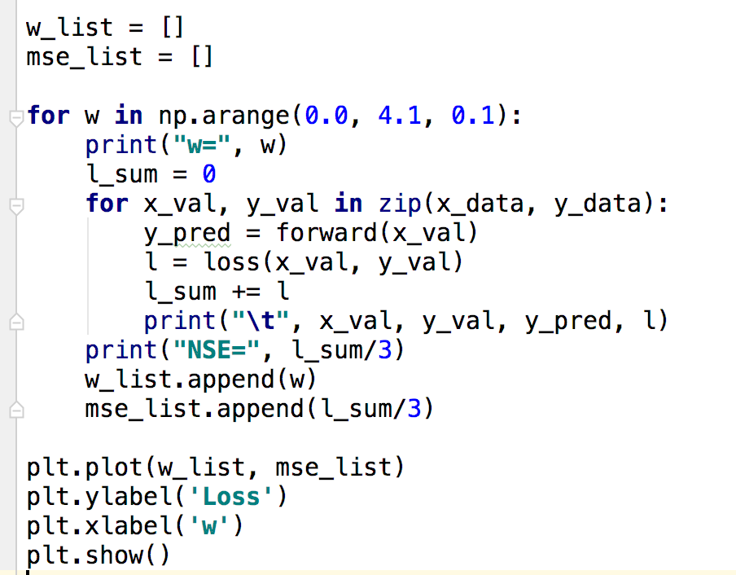
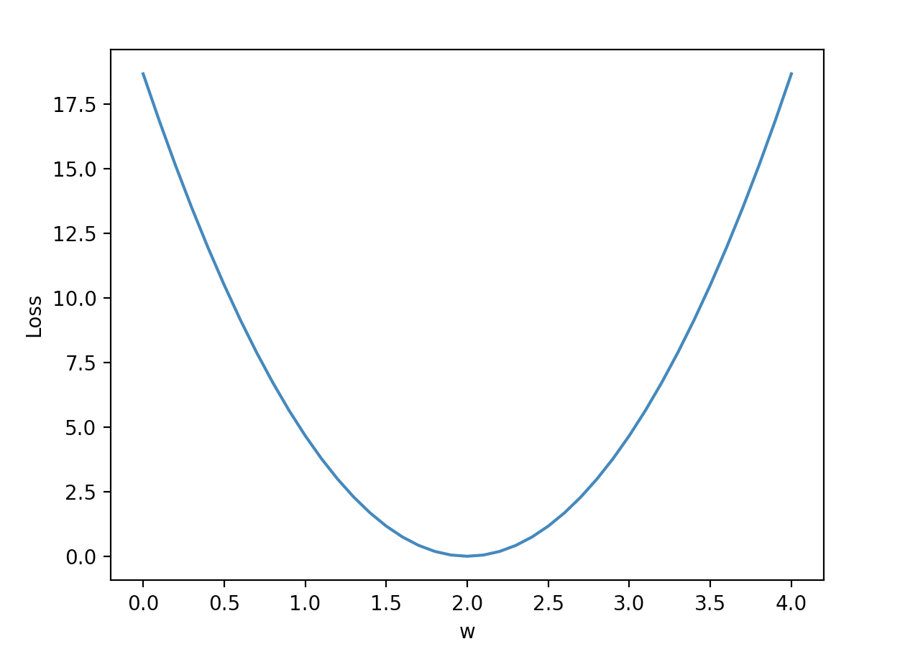
Plot graph

Slide 19
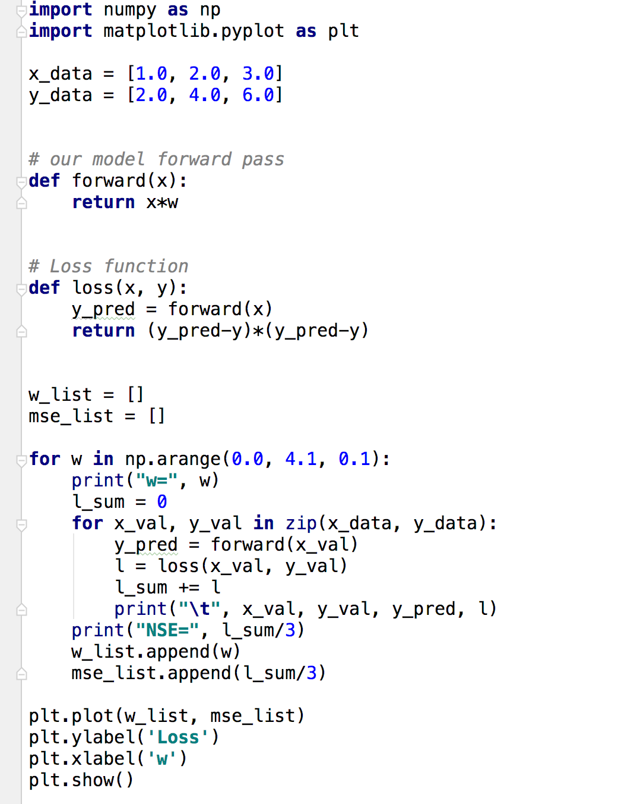
Linear

Slide 20


Lecture 3:
Gradient Descent

